Slide 1
Big data analytics for business insights
Transforming data into smart decisions
Project id:-sic/team/410
Govt college for women(gcw), karnal
Bca final year

Slide 2
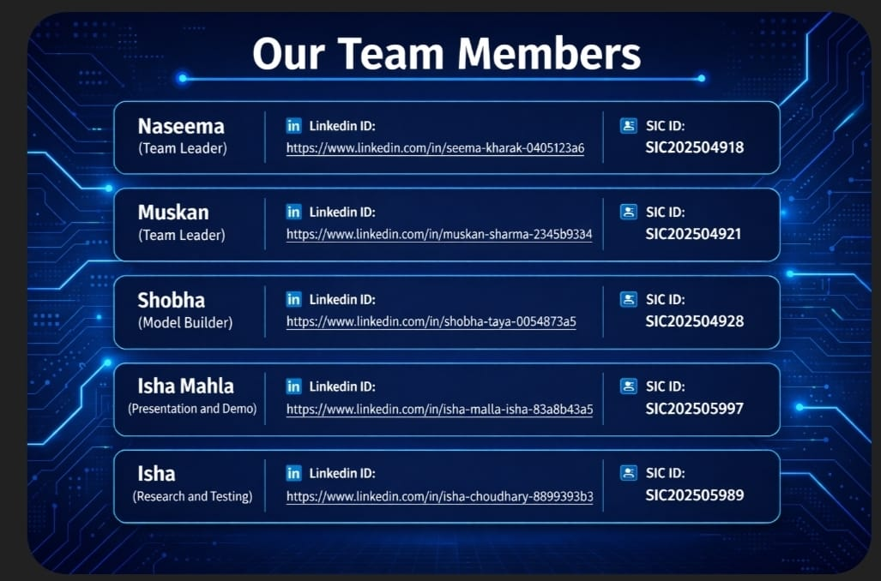





team member detailser details

Slide 3
introduction
BIG DATA REFERS TO EXTREMELY LARGE AND COMPLEX DATASETS.
TRADITIONAL TOOLS CAN’T HANDLE SUCH DATA EFFICIENTLY
BUSINESSES USE BIG DATA ANALYTICS TO GAIN INSIGHTS AND IMROVE DECISION-MAKING
IN TODAY’S DIGITAL WORLD ,MASSIVE AMOUNT OF DATA ARE GENERATED EVERY SECOND FROM VARIOUS SOURCES LIKE SOCIAL MEDIA,ONLINE TRANSACTIONS AND SMART DEVICES.
THESE INSIGHTS SUPPORT BETTER DECISION MAKING AND BUSINESS GROWTH.

Slide 4
What is big data?
Big data refers to extremely large datasets that can’t be processed using traditional data management tools.
It includes structured data(tables),semi-structured data(JSON,HTML) and unstructured data(videos,images,text).
5v’s explained:-
Volume:-Huge amount of data generated daily.
Velocity:- Speed at which data is generated and processed
Variety:-Different types of data formats
Veracity:-Accuracy and reliability of data
Value:-Useful insights extracted from data

Slide 5
Souces of big data
Social Media Platforms: User posts, likes, comments provide insights into customer behavior
E-commerce Transactions: Purchase history, payment details, and browsing behavior
IoT Devices: Sensors, smart watches, smart home devices generate real-time data
Mobile Applications: User activity,location, preferences
Business Systems: ERP, CRM systems store organizational data

Slide 6
Technologies used
Hadoop:
Open-source framework
Stores and processes large datasets using
distributed systems
Apache Spark:
Faster than Hadoop
Used for real-time data processing
NoSQL Databases:
Flexible and scalable (MongoDB, Cassandra)
Handle unstructured data
Cloud Computing:
Platforms like AWS, Azure, Google Cloud
Provide scalable storage and computing power

Slide 7
Big data analytics process
1. Data Collection: Gathering data from multiple sources
2. Data Storage: Storing data in databases or cloud systems
3. Data Processing: Cleaning and organizing raw data
4. Data Analysis: Applying algorithms and tools to analyze data
5. Data Visualization: Presenting results using charts and dashboards
6. Decision Making: Using insights to make business decisions

Slide 8
Types of analytics
Descriptive Analytics:
Analyzes past data
Example: Monthly sales report
Diagnostic Analytics:
Finds reasons behind events
Example: Why sales dropped
Predictive Analytics:
Uses data to predict future outcomes
Example: Forecasting demand
Prescriptive Analytics:
Suggests actions to achieve desired outcomes
Example: Best marketing strategy

Slide 9
Business application
Customer Analysis: Understanding customer preferences and behavior
Market Analysis: Identifying trends and opportunities
Fraud Detection: Detecting suspicious activities in banking
Supply Chain Optimization: Improving logistics and Inventory management
Personalization: Recommending products/services to users

Slide 10
Real life examples
Amazon: Uses data analytics to recommend products based on user behavior
Netflix: Suggests movies/shows using viewing history
Google: Improves search results using user data
Banking Sector: Detects fraud using transaction patterns

Slide 11
Benefits of big data
Helps organizations make informed decisions
Improves operational efficiency
Reduces business risks
Enhances customer satisfaction
Provides competitive advantage in the market
Faster innovation
Predective maintenance
Risk management and security

Slide 12
challenges
Data Privacy: Protecting user data is difficult
High Cost: Infrastructure and tools are expensive
Security Risks: Data breaches and cyber attacks
Data Management: Handling large volumes of data
Skill Gap: Need for skilled data professionals
Analytical complexity: extracting meaningful value from massive and noisy datasets requires advanced, often specialized ,tools and techniques.

Slide 13
Future scope
Integration with Artificial Intelligence and Machine Learning
Growth of real-time analytics systems
Increased use in healthcare, education and smart cities
Automation of decision-making processes
Expansion of lot and connected devices.

Slide 14
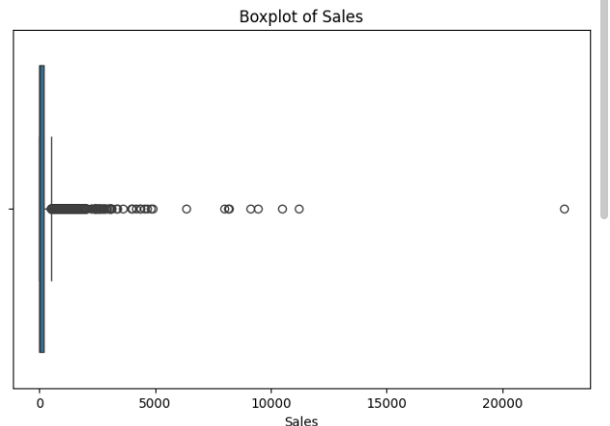
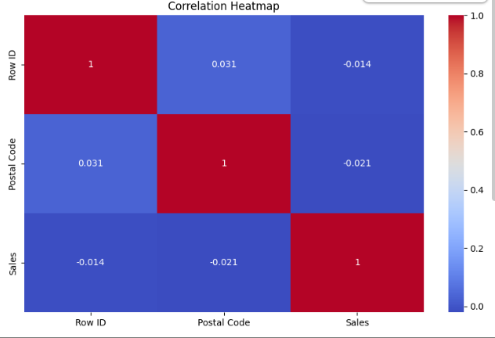
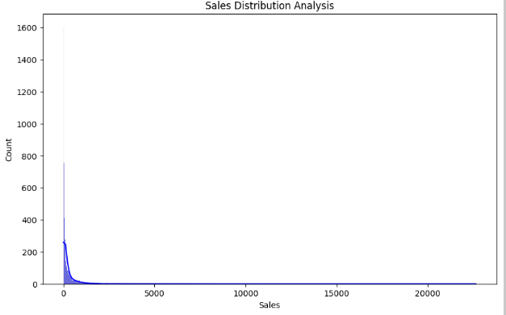
Dashboard / insights

Slide 15
conclusion
Big Data Analytics is a powerful tool for modem businesses
It transforms raw data into meaningful insights
Helps organizations stay competitive and Innovative
Plays a crucial role in future technological advancements

Slide 16


